Slide 1
KNCV experience with PV/aDSM
Symposium 12
Suzanne Verver, Agnes Gebhard,
Susan van den Hof, Gunta Dravniece,
Svetlana Pak, Sandra Kik

Slide 2
USAID’s flagship TB control project October 2014 - September 2019

Slide 3
Notes:
Slide only needed in case USAID does not present

Slide 4
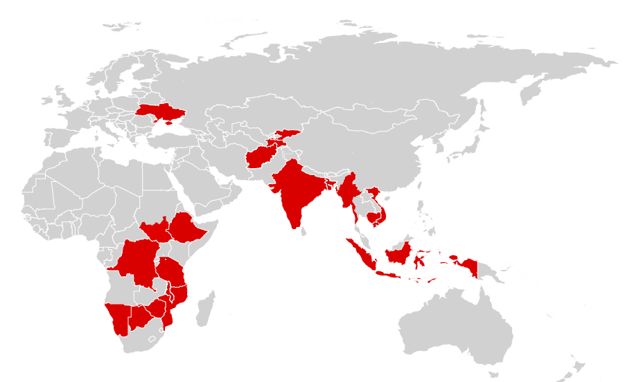
Challenge TB currently active in 21 countries and the East African region

Slide 5
Introduction of BDQ with Challenge TB support
15/21 | Started 2013, 2014 (TBCAREI) | Started 2015 (APA1) | 2015-2016 ( APA2)
Ukraine |  |  | Assessment, site selection, dg algorithm, regimen design, protocol, PV, trainings, patient enrolment
Kyrgyzstan |  | BDQ regimen design, protocols, PV, assistance to regulatory issues | Diagnostic algorithm, regimen design, protocols, PV, trainings, patient enrolment
Tajikistan |  | BDQ regimen design, protocols, PV, assistance to regulatory issues , quantification | Dg algorithm, regimen design, protocols, PV, trainings, patient enrolment, assistance to regulatory issues , quantification
Uzbekistan |  |  | BDQ introduction and SR
Ethiopia |  |  | BDQ introduction and SR
Nigeria |  | Introductory WS, assessment pilot site | Continued support to introduction of BDQ
Botswana |  |  | Regulatory support, introductory WS
Tanzania |  | Planning WS BDQ and shorter regimen | Decentralization of PMDT and shorter regimen
DR Congo |  |  | TA, WS, training for BDQ introduction
India |  |  | Quarterly review meetings 6 BDQ pilots
Bangladesh |  |  | KCNV involved in shorter regimen only
Burma |  | Assessment readiness for BDQ and PV | Support to PV system, BDQ
Indonesia |  | 7 patients on BDQ, PV by full CEM | Support to BDQ implementation, SR and DLM introduction
Vietnam |  | 25/11 first pts on BDQ, intermediate level PV, start 9 month regimen 12/2015 | Support to BDQ implementation, SR and DLM introduction
Cambodia |  |  | KNCV invited for assessment of readiness for BDQ implementation

Slide 6
Timelines for BDQ/aDSM introduction (to be customized per country)
Steps Month |  | M1 | M2 | M3 | M4 | M5 | M6 | M7 | M8 | M9 | M10 | M11 | M 12
1 | Initial assessments, political commitment, planning, regimen design, protocols, diagnostic algorithms
2 | Development of laboratory capacity
3 | Procurement and Supply Chain Management
4 | Early treatment access in referral clinic
5 | Programmatic preparations: PV , training curricula, strengthening M&E system
6 | Scale-up
7 | Overall coordination and monitoring of progress
Notes:
Experience from pathfinding countries show that the initial steps may take longer. Delays can be due to e.g. protocol approva, drug regulatory issues etc.

Slide 7
In practice (KNCV approach icw country)
On site: Recording of all AEs of clinical significance
In patient’s file
In electronic R&R system
For patient management by treating clinician
To NTP: (Aggregate) reporting of AEs of clinical significance Note: only needed if no eR&R in step 1
Programmatic analysis – what elements need further attention/training etc
Forecasting of ancillary drugs
To PV center: Reporting of at least SAEs
National PV centre with NTP: responsible for linking clinical, PV and other relevant expertise needed for causality assessment

Slide 8
KNCV approach: aDSM in support of access
Systematic approach for all MDR-TB patients (starting in pilot sites) – ensuring good clinical management for all
Ensure early access under good treatment and follow-up conditions at MDR treatment center to gain confidence, while building the aDSM programmatic conditions to provide further training / supervision in support of role-out
International “hotline” with the KNCV clinical support group
Ensure HSS approach – TB as a means to strengthen the PV system
Integration of standardized AE recording and reporting in existing R&R systems (both at NTP and PV centre side)
Including private sector providers in the planning for scale-up
Notes:
Ask Agnes to explain the red sentences to me

Slide 9
KNCV Practical steps building PV for MDRTB
Steps towards a functioning PV system | months until programmatic PV
 | 6 | 5 | 4 | 3 | 2 | 1 | 0 | Roll-out
Create national NTP/NPVC coordinating mechanism
Decide on level of PV needed - Develop PV protocol
Define roles ,responsibilities each level NTP and NPVC
Develop human resource plan
Define local list of data elements and data dictionary
Decide on eR&R system for PV data collection
Customize/design new or adjust existing eR&R system
Include PV data elements in MDR-TB data collection tools
Develop data management plan
Develop SOPs
Training on PV for all staff involved
Add specific experts to the national Pharmaceutical Safety team for causality assessment
Test electronic data collection system
Pilot data collection and processing up to national level
Start (programmatic) PV implementation

Slide 10
Evaluate short regimens & new drugs under Operational/implementation Research conditions?
 | Short regimens | New drugs
WHO use under OR conditions | Yes |  | OR can cover all criteria.
Close monitoring | Yes | Yes
Monitoring =>12mo after treatment | Yes
National ethics review | Yes | No, but informed consent needed
Assess treatment effectiveness | Yes | Yes, through M&E
Assess treatment safety | Yes | Yes, through aDSM
Careful patient selection | Yes | Yes
Monitoring by an independent monitoring board reporting to WHO | Yes*
* Recommended by WHO, but not done in all countries
Notes:
Short regimens: http://www.who.int/tb/challenges/mdr/short_regimen_use/en/
Bedaquilline: http://www.who.int/mediacentre/news/notes/2013/bedaquiline_mdr_tb_20130613/en/
Delamanid: http://www.who.int/tb/features_archive/delamanid/en/ (28 Oct 2014)

Slide 11
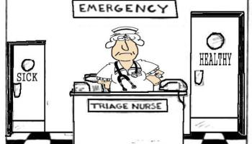
Proposed triaging and treating of MDR-TB patients
Aim: Quick triaging of TB patients to allow for fast and appropriate treatment initiation
Presumptive TB cases / High risk groups for MDR
Diagnostic algorithm (triaging)
Drug susceptible
(RIF-)
(uncomplicated) MDR
(RIF+)
Pre-XDR
(RIF+ & FQ+ or
RIF+ & SLI+)
XDR
(RIF+ & FQ+ & SLI+)
Cat 1 treatment
Short MDR treatment
MDR regimen containing new drugs
Notes:
Aim: fast diagnosis of MDR, XDR and fast treatment initiation (least toxic one that is still effective) to decrease burden on patient, health system, improve treatment outcomes.

Slide 12
Proposed triaging and treating of MDR-TB patients
Aim: Quick triaging of TB patients to allow for fast and appropriate treatment initiation
Presumptive TB cases / High risk groups for MDR
Diagnostic algorithm (triaging)
Drug susceptible
(RIF-)
(uncomplicated) MDR
(RIF+)
Pre-XDR
(RIF+ & FQ+ or
RIF+ & SLI+)
XDR
(RIF+ & FQ+ & SLI+)
Cat 1 treatment
Short MDR treatment
MDR regimen containing new drugs
Notes:
Aim: fast diagnosis of MDR, XDR and fast treatment initiation (least toxic one that is still effective) to decrease burden on patient, health system, improve treatment outcomes.

Slide 13
Proposed triaging and treating of MDR-TB patients
Aim: Quick triaging of TB patients to allow for fast and appropriate treatment initiation
Presumptive TB cases / High risk groups for MDR
Diagnostic algorithm (triaging)
Drug susceptible
(RIF-)
(uncomplicated) MDR
(RIF+)
Pre-XDR
(RIF+ & FQ+ or
RIF+ & SLI+)
XDR
(RIF+ & FQ+ & SLI+)
Cat 1 treatment
Short MDR treatment
MDR regimen containing new drugs
Notes:
Aim: fast diagnosis of MDR, XDR and fast treatment initiation (least toxic one that is still effective) to decrease burden on patient, health system, improve treatment outcomes.

Slide 14
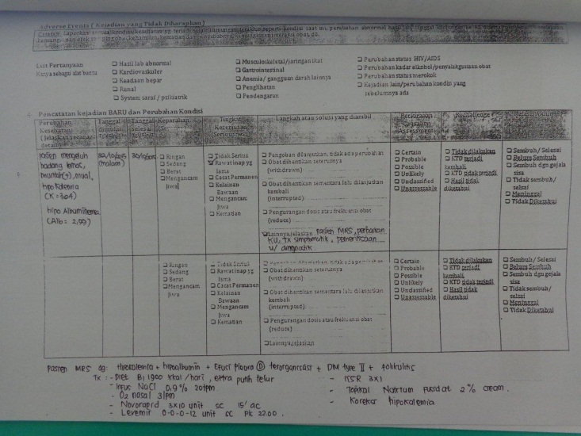
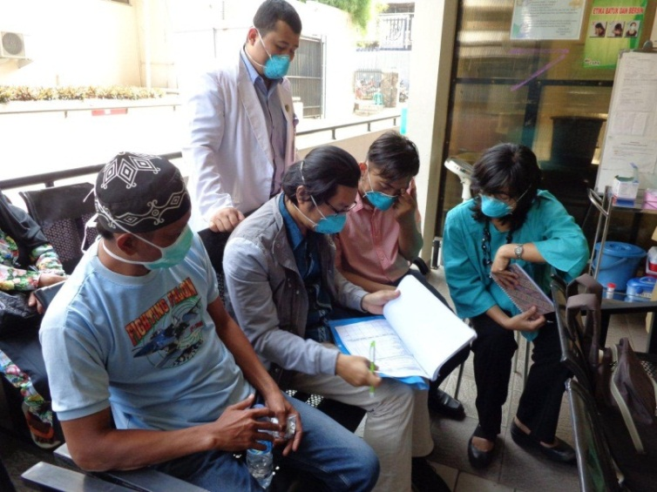
Country experiences
Working since 2 years on new drugs/regimens and PV:
Indonesia : ~ aDSM advanced package
Vietnam : aDSM intermediate package
Recent introduction: Kyrgyzstan & Tajikistan:
Situation assessment
Development of National Plan for introduction of new drugs and regimens
Planning start patient triage and treatment June 2016

Slide 15
Country experience Tajikistan
Joint rGLC/GDF mission recommended to start using new drugs & regimens (June 2015)
Situation analysis (August 2015). Main findings:
Weak link between NTP and drug regulatory agency (DRA)
Not enough lab tests for monitoring introduction of new regimens
No use of yellow forms
Adverse events being registered in 3 places (patient folder, TB01 form and AE register), but unclear which selection and summaries not being used
No formal causality assessment
MSF started giving BDQ on small scale, using own electronic PV system

Slide 16
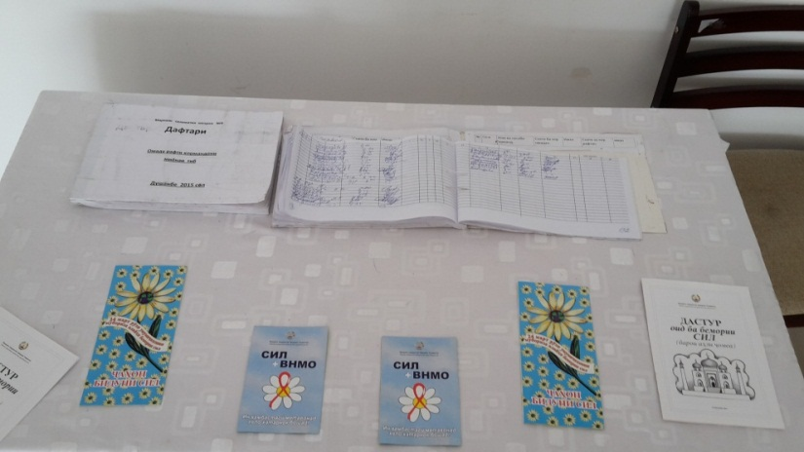
Tajikistan PV experience
Assessment of preparedness for implementation of shortened regimens and new drugs: NTP decision on use of triage strategy (September 2015)
KNCV assisted with:
Facilitating link between NTP and Drug Regulatory Agency: TB is pilot.
Applying for membership of the WHO Program for International Drug Monitoring, by Uppsala Monitoring Centre (June 2015)
Developing national plan on introduction of new drugs/regimens (November 2015)
Establishing PV thematic working group and plan causality assessment group
PV workshop to finalise and approve PV plan, forms and flow of forms (December 2015)

Slide 17
NEXT STEPS
With WHO and other partners continue development of implementation tools
Use / develop mobile technology to support DOT providers in the monitoring and management of AEs
Develop sentinel sites / countries for a differentiated approach to global reporting of AEs for new drugs
MAINSTREAMING OF aDSM IS A GREAT OPPORTUNITY TO STRENGTHEN CLINICAL MANAGEMENT OF DR TB PATIENTS NATIONWIDE AND IMPROVE TREATMENT OUTCOMES

